Slide 1

Real Time Period-Wise Metrics Analysis on Quick Commerce Platforms
Presented by:
BHUKYA ARAVIND
Batch No: 474

Slide 2
Introduction
Quick commerce platforms like Blinkit and BigBasket deliver groceries and daily essentials within minutes, making them a key part of urban shopping today
The prices, offers and stock availability on these platforms keep changing throughout the day based on demand, time and other factors
This project collects real-time data four times a day Morning, Afternoon, Evening and Night using automated web scraping to track these changes
The goal is to analyze patterns in pricing, discounts, delivery charges and stock availability across different categories and time periods to find useful insights

Slide 3
Dataset Information
Dataset: Real-Time Period-Wise Metrics Analysis on Quick Commerce Platforms
Source: Web Scraped from Blinkit and BigBasket using Selenium (4 times daily).
Column Name | Data Type | Description
name | Categorical | Name of the product listed on the platform
Category | Categorical | Product category (e.g., Vegetable, Milk, Eggs)
mrp | Numerical | Maximum Retail Price of the product in Rupees
selling_price | Numerical | Actual price at which the product is sold in Rupees
offer_percentage | Numerical | Discount percentage applied on the product
delivery_time(MIN) | Numerical | Estimated delivery time in minutes
quantity | Categorical | Product quantity or pack size (e.g., 500g, 1kg)
scrape_date | Categorical | Date on which the data was scraped
scrape_time | Categorical | Time at which the data was scraped
location | Categorical | Area in Hyderabad where data was collected

Slide 4
Column Name | Data Type | Description
Delivery_Charges | Numerical | Total delivery charges including handling fee in Rupees
Period | Categorical | Time period of scraping — Morning, Afternoon, Evening, Night
Climate | Categorical | Weather condition at time of scraping (Clear, Sunny)
Surge_charges | Categorical | Whether surge charges were applied (Yes/No)
Platform | Categorical | Platform name — Blinkit or BigBasket
mrp_range | Categorical | MRP grouped into price ranges (e.g., 0-50, 51-100)
sp_range | Categorical | Selling price grouped into price ranges
Stock | Categorical | Whether product is in stock — True or False

Slide 5
Understanding the Dataset
Data Collection:
Data was scraped from Blinkit and BigBasket using Selenium automation
Scraping was done 4 times daily Morning, Afternoon, Evening and Night
Data was collected from multiple locations in Hyderabad KPHB Colony, Madhapur and Beeramguda
Dataset Overview:
Total Records : 2098 rows
Total Features : 18 columns
Numerical Columns : 5 (MRP, Selling Price, Offer %, Delivery Time, Delivery Charges)
Categorical Columns: 13 (Category, Platform, Period, Location, Climate etc.)
Categories Covered: Vegetable, Milk, Fruit, Eggs, Chicken, Meat, Paneer
Platforms Covered: Blinkit and BigBasket
Time Periods: Morning, Afternoon, Evening, Night

Slide 6
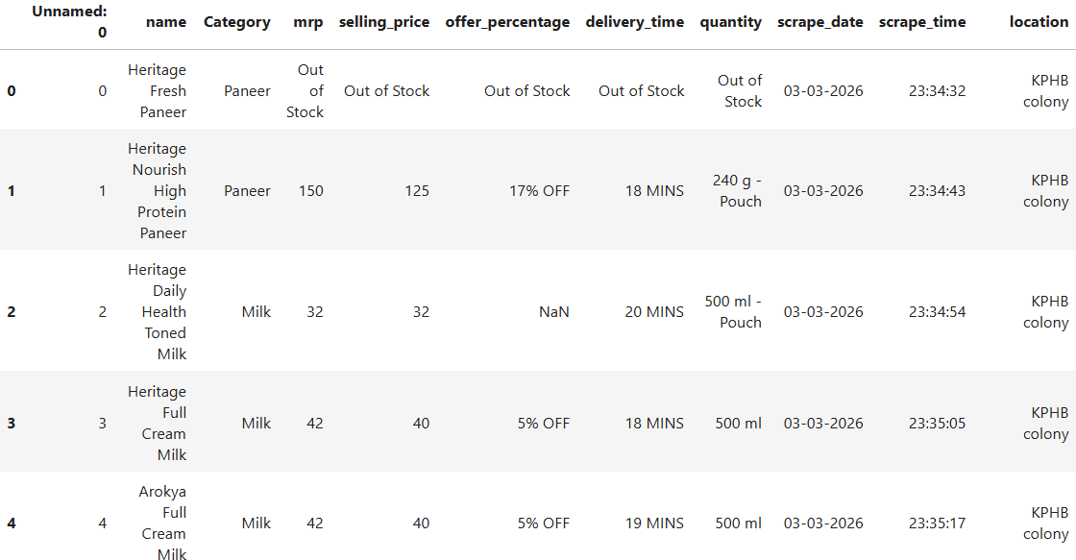
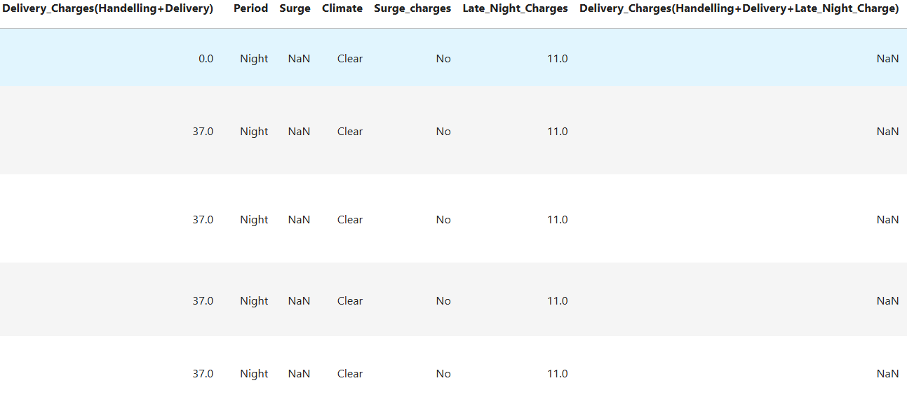

Data Cleaning & Preparation
Raw data after scraped from quick commerce

Slide 7
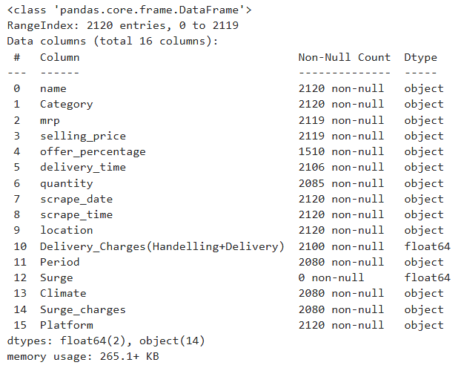
Data Cleaning & Preparation

Slide 8
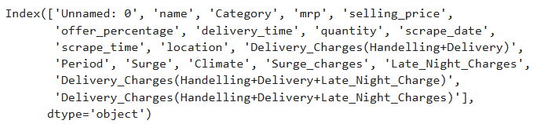
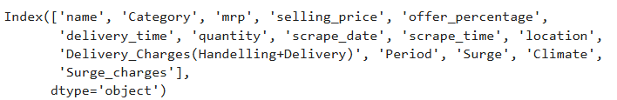
Data Cleaning & Preparation
1. Dropping Duplicate Columns and Changing Column Names
After Dropping columns

Slide 9
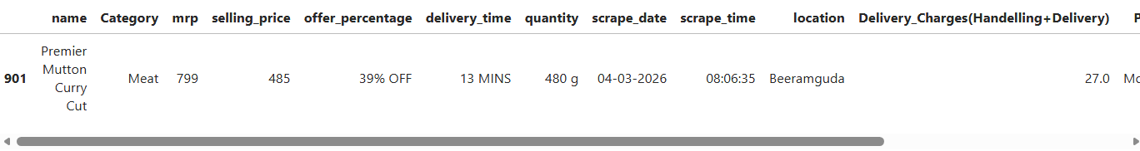
Data Cleaning & Preparation
2. Duplicate Handling

Slide 10
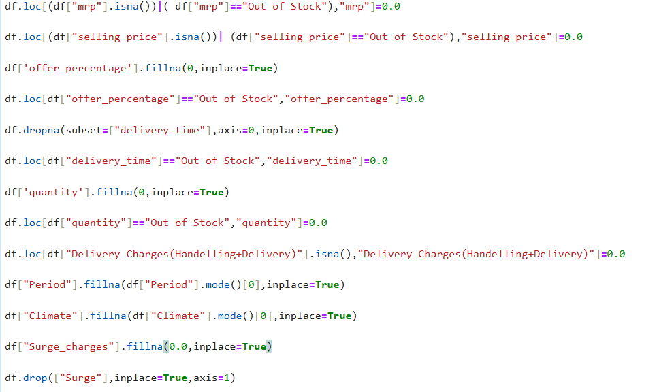
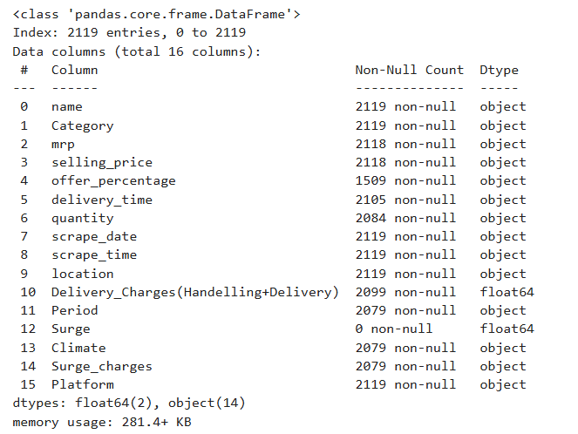
Data Cleaning & Preparation
3. Handling Missing Values

Slide 11
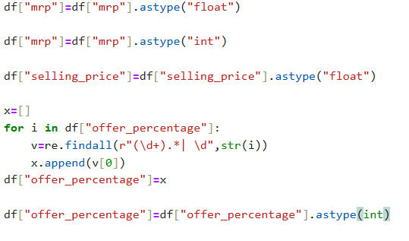
Data Cleaning & Preparation
4. Type Casting

Slide 12
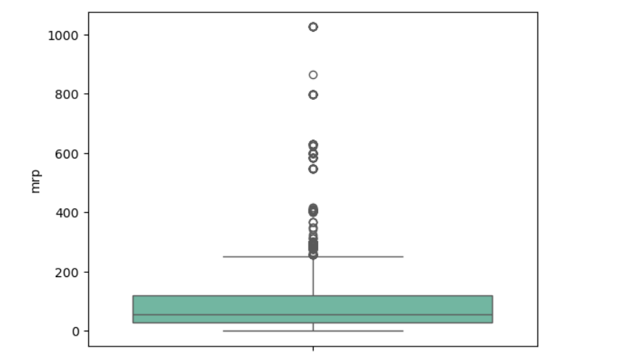
Data Cleaning & Preparation
5. Outlier Detection & Treatment
Outliers in MRP Column but we are not Handling
Because MRP is a real price, those high-value items (₹800, ₹1000) are likely genuine premium products like Meat. Removing them would lead to loss of real data

Slide 13
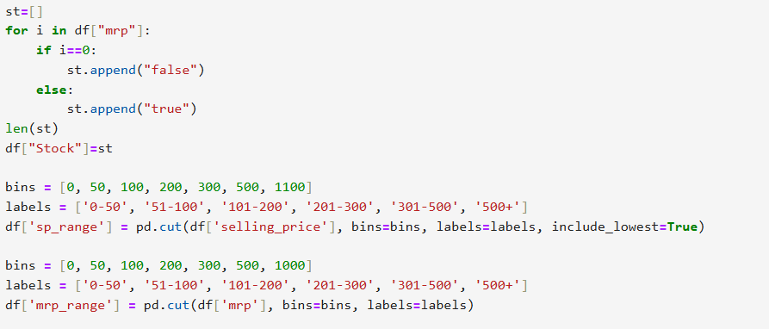
Data Cleaning & Preparation
6. Adding Few More Columns For Good Interpretation

Slide 14
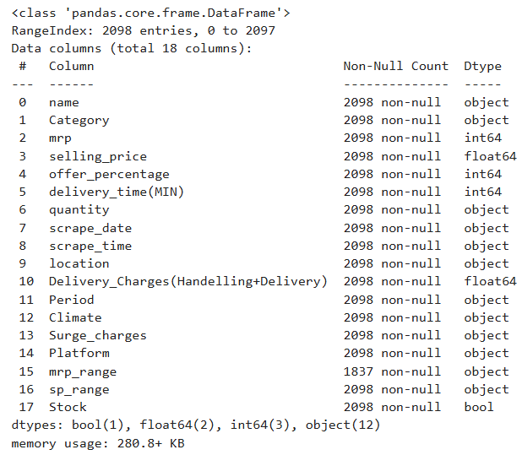
Data Cleaning & Preparation

Slide 15
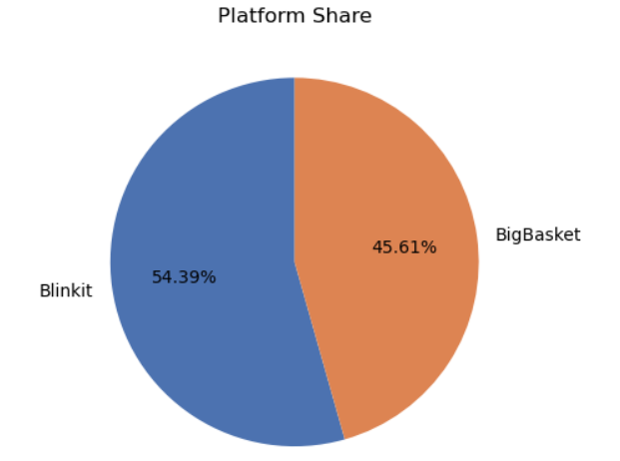
EDA → Univariate Analysis
Platform Share in Dataset
From the scrapped data Blinkit share is 54.39 percent and Bigbasket share is 45.61 percent.

Slide 16
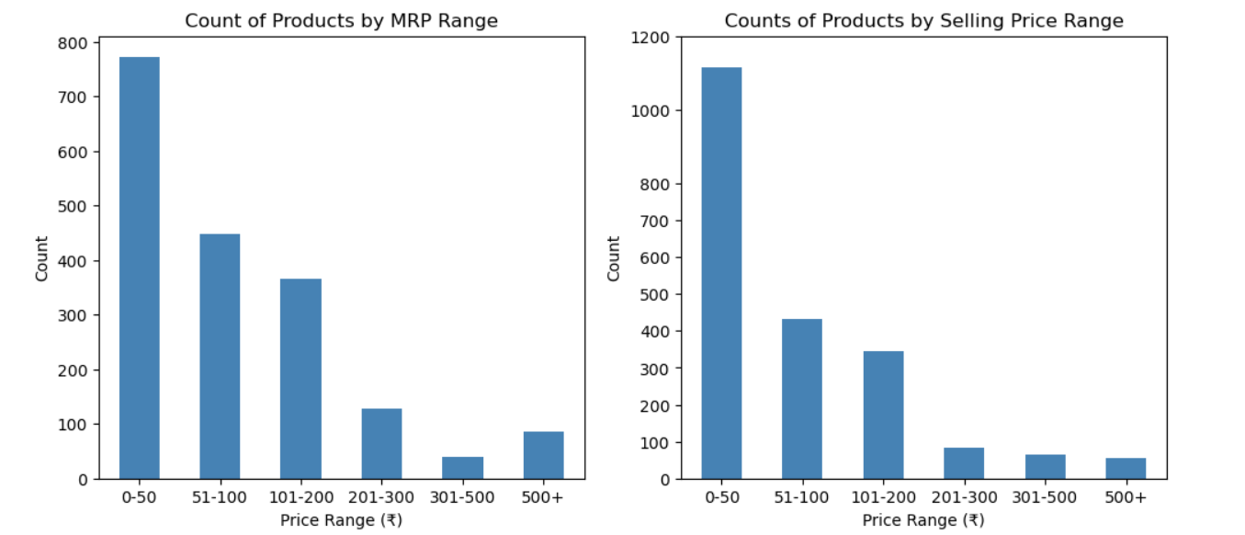
MRP , Selling Price Range VS Count Of Product
From plot 1 we can observe that 0-50 range price products count is nearly 800.
From plot 2 0-50 range price products count has increase to above 1000 after applying discount. Others remains same.¶

Slide 17
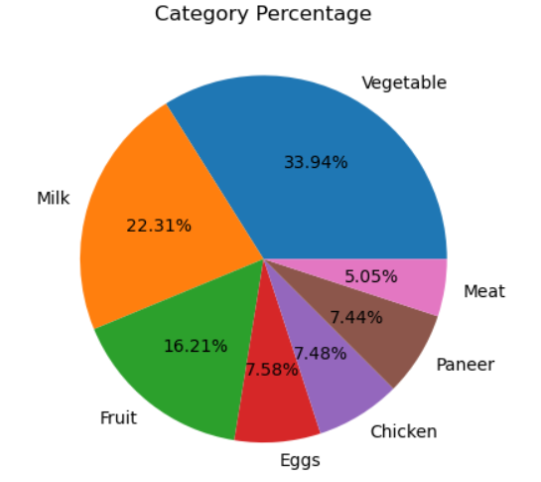
Category Percentage
Vegetable has highest share among all categories with 33.94%
Meat has the lowest share at 5.05%
Eggs, Chicken, Panner and Meat are less than 10%

Slide 18
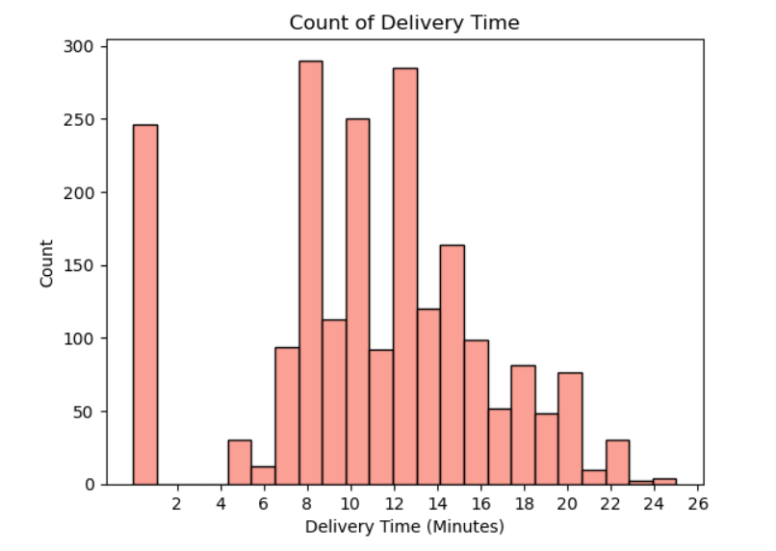
Delivery Time Count
0 mins indicates product is out of stock
Minimum Delivery time is 5 Mins and Maximum delivery time is 25 mins
Most deliveries happen between 8 to 13 minutes

Slide 19
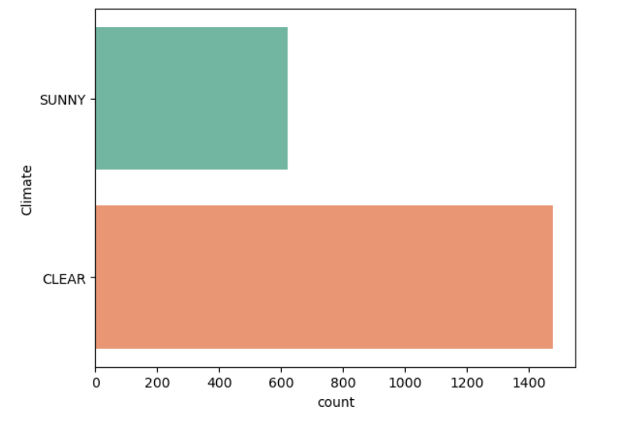
Climate Conditions During Data Collection
In all 4 days most of time, CLEAR climate is present

Slide 20
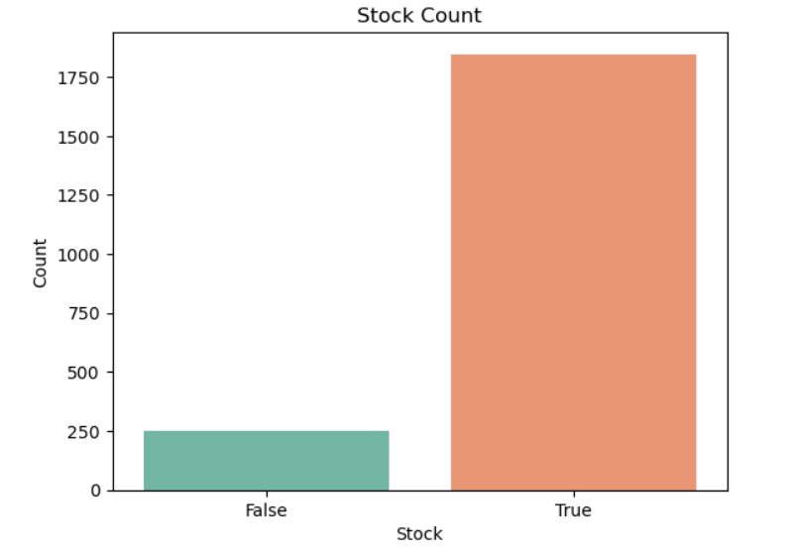
Stock Availability Count
In all 4 days, most of the time Stock is Available

Slide 21
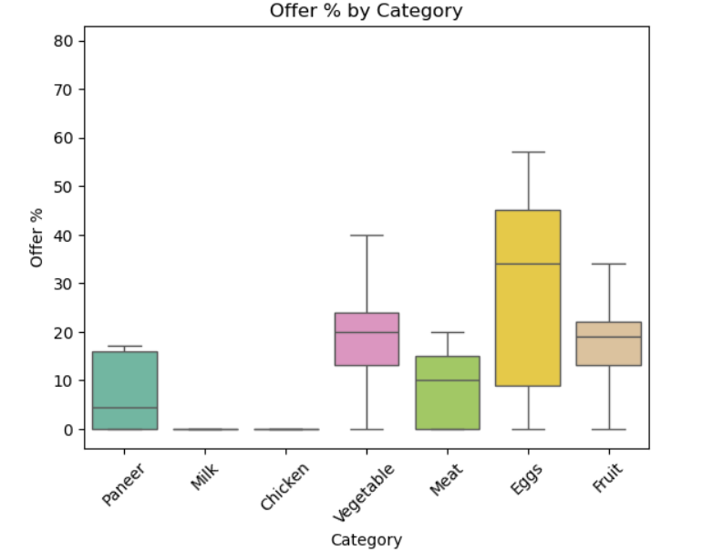
EDA → Bivariate Analysis
Category wise Offer Percentage
Offer percentage of Milk and Chicken is almost zero no discounts are applied on these categories
Average offer percentage of Paneer is around 5% very low discounts
Average offer percentage of Meat is around 15% moderate discounts
Vegetable has an average offer of around 20% with range going up to 40%
Fruit offer percentage ranges between 15% to 25% consistently
Eggs have the highest and most varied offer percentage with average around 35% and range going up to 57%

Slide 22
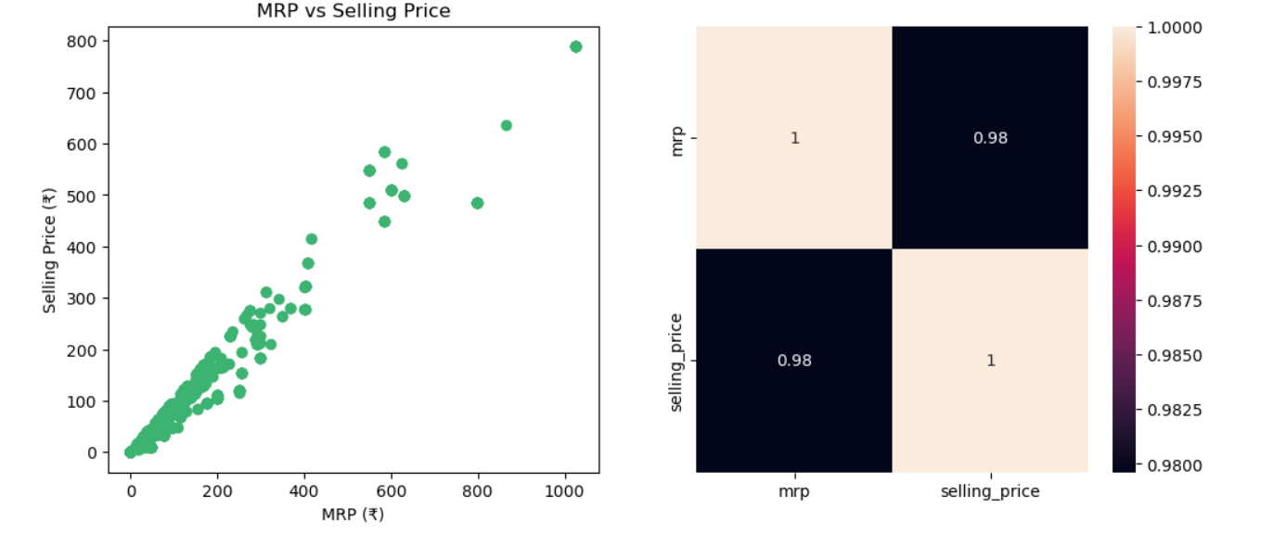
Relation between MRP & Selling Price
There is a positive relationship as MRP increases selling price also increases
The relation is strong with 98% correlation
Majority of products are clustered below ₹200 MRP confirming most items are daily budget essentials

Slide 23
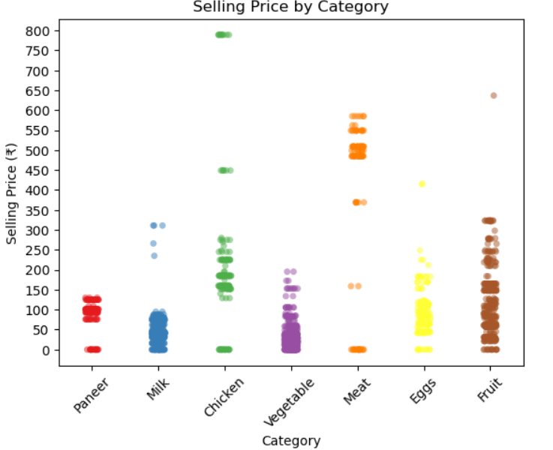
Category wise Selling Price
Points at ₹0 represent out of stock items with no selling price recorded
Paneer selling price falls between ₹80 to ₹150
Milk selling price mostly falls between ₹10 to ₹100, with a few premium variants between ₹250 to ₹350
Chicken selling price ranges between ₹150 to ₹350, with some premium cuts at ₹450 and one outlier near ₹800
Vegetable selling price is mostly between ₹10 to ₹200, with some items between ₹200 to ₹250
Meat selling price is on the higher side, ranging between ₹500 to ₹650
Eggs selling price falls between ₹50 to ₹150
Fruits selling price ranges between ₹50 to ₹350, with one premium item near ₹650

Slide 24
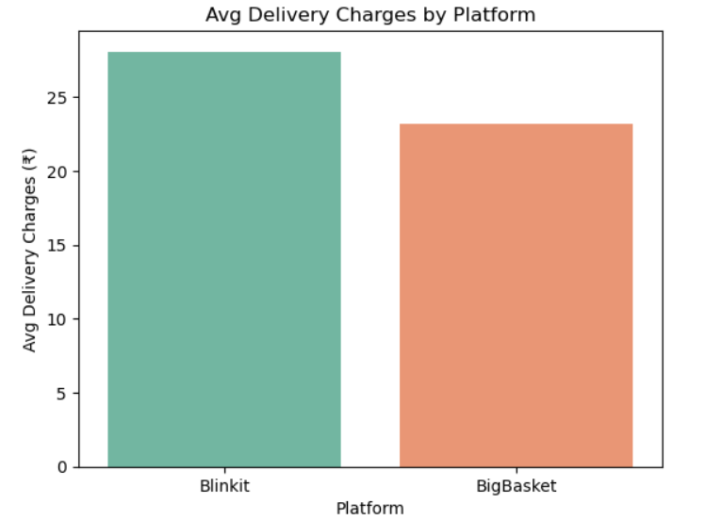
Average Delivery Charges By Platform
Average delivery charges for Blinkit is around ₹28 slightly higher than BigBasket
Average delivery charges for BigBasket is around ₹23 more affordable for customers
Even though BigBasket applies late night delivery fees in some time slots, its overall average delivery charges are still lower than Blinkit

Slide 25
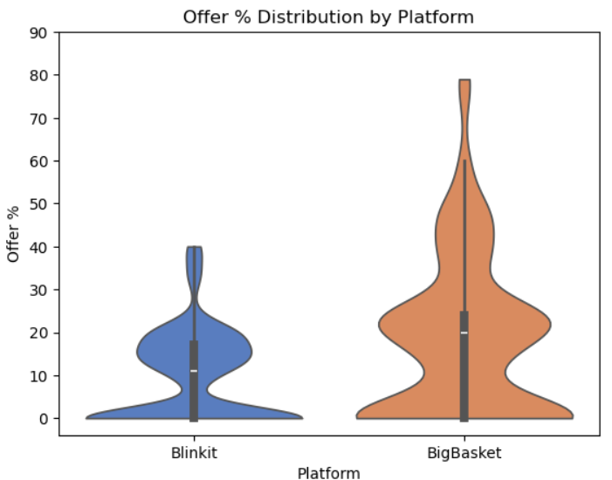
Platform Wise Offer Percentage
Blinkit
Offer percentage mostly lies between 0% to 20% majority of products have low discounts
Low density is around 0% and 10%
Some products have offers between 25% to 40% but with very low density
Big Basket
Offer percentage ranges widely from 0% to 80%
Highest density is around 10 to 30%
Offers between 35% to 80% with less density

Slide 26
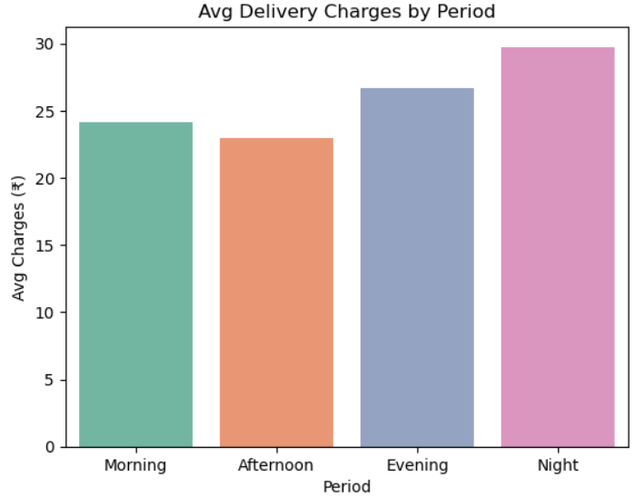
Period Wise Average Delivery Charges
Average delivery charges are lowest in Afternoon at ₹23. Best time to order for cheaper delivery
Morning charges are ₹24. slightly higher than afternoon
Evening charges rise to ₹27. demand increases during evening hours
Night has the highest delivery charges at ₹29
There is a clear pattern. Delivery charges increase from afternoon to night

Slide 27
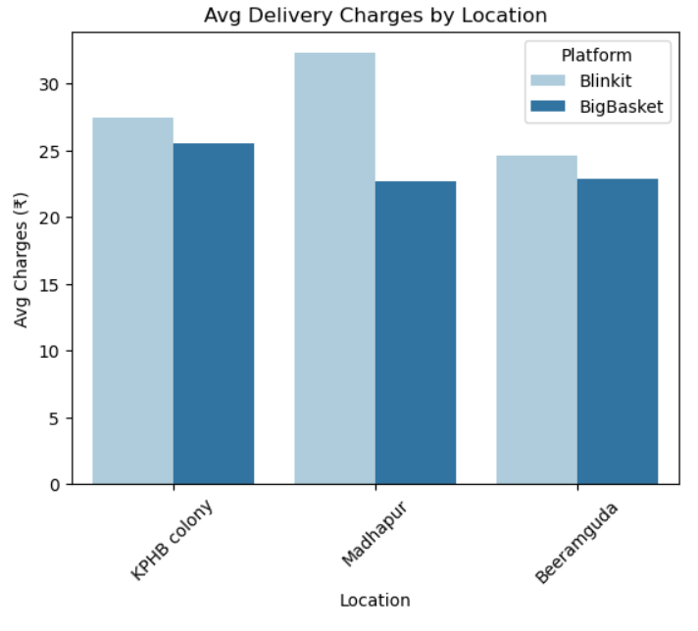
EDA → Multivariate Analysis
Platform Wise Average Delivery Charges by Location
In KPHB Colony, Blinkit charges around ₹27 and BigBasket charges around ₹25
In Madhapur, Blinkit has the highest charges at ₹32 while BigBasket is only ₹23
In Beeramguda, both platforms have similar charges around ₹24 to ₹23

Slide 28
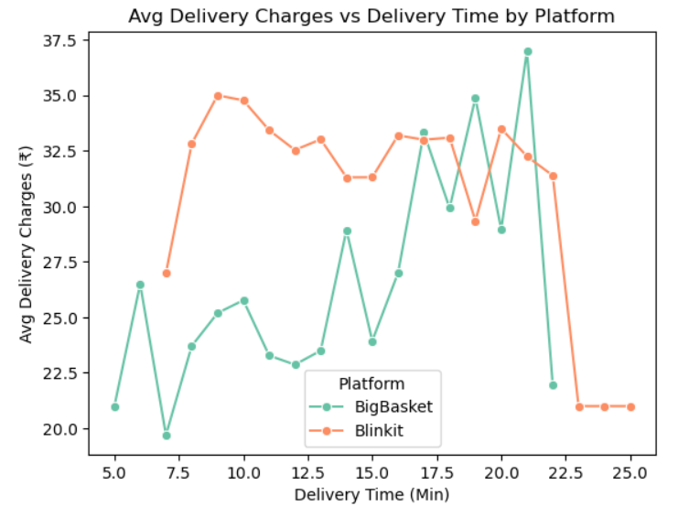
Platform Wise Average Delivery Changes Vs Delivery Time
Blinkit starts at around ₹27 for 5 minute delivery and BigBasket starts at around ₹21 for 5 minute delivery
For delivery time between 10 to 15 minutes, Blinkit average charges are around ₹30 to ₹35 and BigBasket is around ₹23 to ₹26
For delivery time between 20 to 25 minutes, both platforms show fluctuating
Maximum delivery time for Blinkit is around 25 minutes and for BigBasket is around 21 minutes
For delivery time between 7 to 10 minutes, Blinkit and bigbasket charges gradually increase and then slightly decrease after 10 minutes

Slide 29
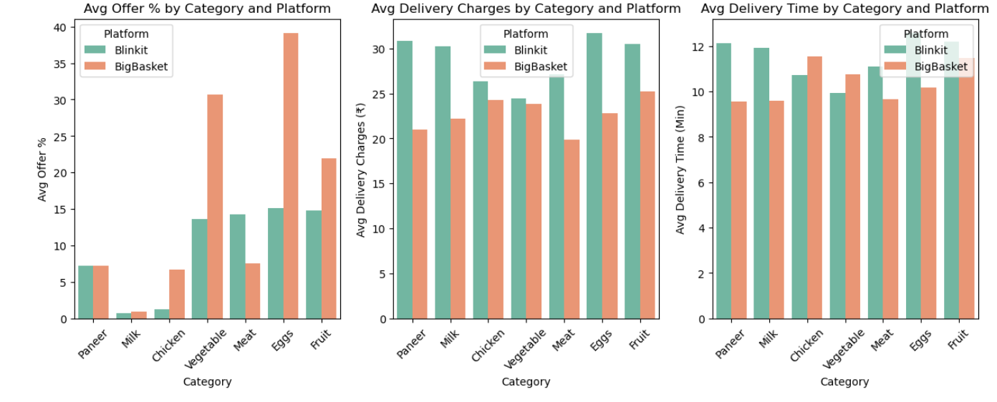
Avg Offer Percentage Vs Avg Delivery Charges Vs Delivery Time with respective platform and category

Slide 30
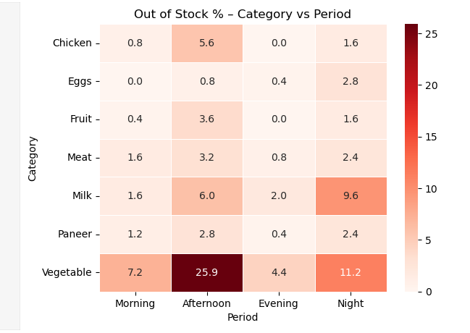
Period Wise Out of Stock Count with respective Category
Vegetable has the highest out of stock across all periods Afternoon alone accounts for 26% of all out of stock cases
Chicken goes out of stock heavily in Afternoon at 5.6% and drops to 0% in Evening restocking likely happens between Afternoon and Evening
Fruit goes out of stock mostly in Afternoon at 3.6% and 0% in Evening similar restocking pattern as Chicken
Meat shows consistent out of stock across all periods Morning 1.6%, Afternoon 3.2%, Evening 0.8% and Night 2.4%
Milk goes out of stock most at Night at 9.6% highest night demand among all categories
Paneer highest out of stock is in Afternoon at 2.8% low overall compared to other categories

Slide 31
Conclusion
The project successfully analyzed price, offer, stock and delivery patterns of daily essential products across Blinkit and BigBasket at four different time periods
Real-time product data was effectively collected using Selenium web scraping four times daily
BigBasket provides better discounts and lower delivery charges across most categories while Blinkit takes slightly more time and charges more for delivery
Vegetables have the highest out of stock rate especially in Afternoon
Evening is the best time to order across all categories

Slide 32

THANK YOU

